Slide 1




Tree and Graph Traversal Algorithms
Breadth-First Search (BFS) and Depth-First-Search (DFS)
DFS and BFS
SoftUni Team
Technical Trainers
Software University
http://softuni.bg

Slide 2

Table of Contents
Traversing Tree-Like Structures
Breadth-First Search (BFS)
Queue-based implementation
Depth-First Search (DFS)
Recursive implementation
Stack-based implementation

Slide 3
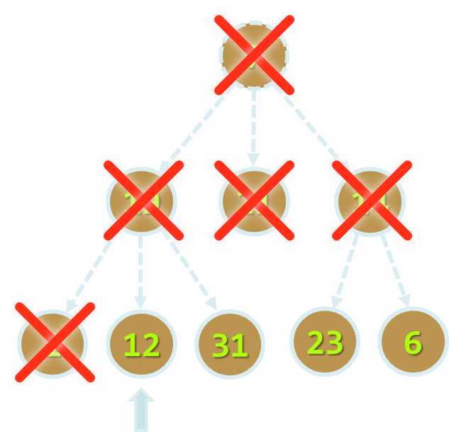
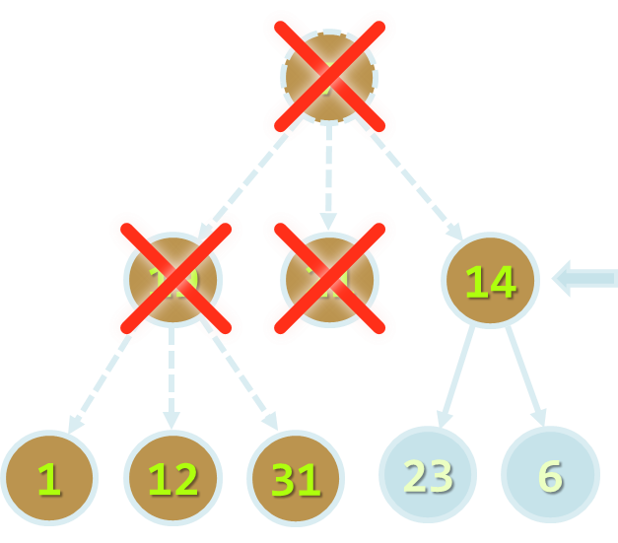
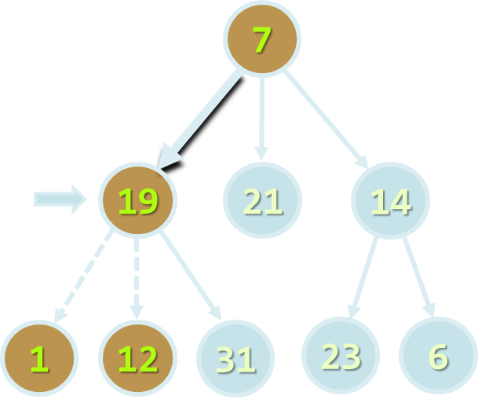
Traversing Tree-Like Structures
DFS and BFS Traversals

Slide 4
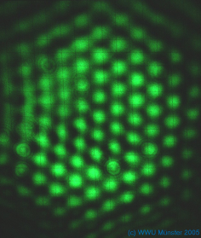
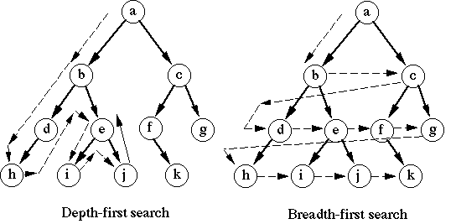
Tree Traversal Algorithms
Traversing a tree means to visit each of its nodes exactly once
The order of visiting nodes may vary on the traversal algorithm
Depth-First Search (DFS)
Visit node's successors first
Usually implemented by recursion
Breadth-First Search (BFS)
Nearest nodes visited first
Implemented by a queue

Slide 5
Depth-First Search (DFS)
Depth-First Search (DFS) first visits all descendants of given node recursively, finally visits the node itself
DFS algorithm pseudo code:
9
7
DFS (node)
{
for each child c of node
DFS(c);
print node;
}
4
19
5
21
8
14
1
2
3
6
7
1
12
31
23
6

Slide 6
DFS in Action (Step 1)
Stack: 7
Output: (empty)
Start DFS from the tree root
7
19
21
14
1
12
31
23
6

Slide 7
DFS in Action (Step 2)
Stack: 7, 19
Output: (empty)
Enter recursively into the first child
7
19
21
14
1
12
31
23
6

Slide 8
DFS in Action (Step 3)
Stack: 7, 19, 1
Output: (empty)
Enter recursively into the first child
7
19
21
14
1
12
31
23
6

Slide 9
DFS in Action (Step 4)
Stack: 7, 19
Output: 1
Return back from recursion and print the last visited node
7
19
21
14
1
12
31
23
6

Slide 10
DFS in Action (Step 5)
Stack: 7, 19, 12
Output: 1
Enter recursively into the first child
7
19
21
14
1
12
31
23
6

Slide 11
DFS in Action (Step 6)
Stack: 7, 19
Output: 1, 12
Return back from recursion and print the last visited node
7
19
21
14
1
12
31
23
6

Slide 12
DFS in Action (Step 7)
Stack: 7, 19, 31
Output: 1, 12
Enter recursively into the first child
7
19
21
14
1
12
31
23
6

Slide 13
DFS in Action (Step 8)
Stack: 7, 19
Output: 1, 12, 31
Return back from recursion and print the last visited node
7
19
21
14
1
12
31
23
6

Slide 14
DFS in Action (Step 9)
Stack: 7
Output: 1, 12, 31, 19
Return back from recursion and print the last visited node
7
19
21
14
1
12
31
23
6

Slide 15
DFS in Action (Step 10)
Stack: 7, 21
Output: 1, 12, 31, 19
Enter recursively into the first child
7
19
21
14
1
12
31
23
6

Slide 16
DFS in Action (Step 11)
Stack: 7
Output: 1, 12, 31, 19, 21
Return back from recursion and print the last visited node
7
19
21
14
1
12
31
23
6

Slide 17
DFS in Action (Step 12)
Stack: 7, 14
Output: 1, 12, 31, 19, 21
Enter recursively into the first child
7
19
21
14
1
12
31
23
6

Slide 18
DFS in Action (Step 13)
Stack: 7, 14, 23
Output: 1, 12, 31, 19, 21
Enter recursively into the first child
7
19
21
14
1
12
31
23
6

Slide 19
DFS in Action (Step 14)
Stack: 7, 14
Output: 1, 12, 31, 19, 21, 23
Return back from recursion and print the last visited node
7
19
21
14
1
12
31
23
6

Slide 20
DFS in Action (Step 15)
Stack: 7, 14, 6
Output: 1, 12, 31, 19, 21, 23
Enter recursively into the first child
7
19
21
14
1
12
31
23
6

Slide 21
DFS in Action (Step 16)
Stack: 7, 14
Output: 1, 12, 31, 19, 21, 23, 6
Return back from recursion and print the last visited node
7
19
21
14
1
12
31
23
6

Slide 22
DFS in Action (Step 17)
Stack: 7
Output: 1, 12, 31, 19, 21, 23, 6, 14
Return back from recursion and print the last visited node
7
19
21
14
1
12
31
23
6

Slide 23
DFS in Action (Step 18)
Stack: (empty)
Output: 1, 12, 31, 19, 21, 23, 6, 14, 7
DFS traversal finished
7
19
21
14
1
12
31
23
6

Slide 24
Depth-First Search (DFS) for Graphs
The DFS algorithm for graph traversals should visit each node exactly once → it should track all visited / unvisited nodes:
visited[0 … n-1] = false;
for (v = 0 … n-1) DFS(v)
DFS (node)
{
if not visited[node] {
visited[node] = true;
for each child c of node
DFS(c);
print node;
}
}
0
6
3
1
4
5
7
8
2

Slide 25
Lab Exercise
0
6
0
0
7
3
1
2
1
2
1
6
4
5
7
3
5
3
4
8
2
Find the Connected Components in a Graph with DFS

Slide 26
Breadth-First Search (BFS)
Breadth-First Search (BFS) first visits the neighbor nodes, then the neighbors of neighbors, etc.
BFS algorithm pseudo code:
1
7
BFS (node)
{
queue ← node
while queue not empty
v ← queue
print v
for each child c of v
queue ← c
}
2
19
3
21
4
14
5
6
7
8
9
1
12
31
23
6

Slide 27
BFS in Action (Step 1)
Queue: 7
Output:
Initially enqueue the root node
7
19
21
14
1
12
31
23
6

Slide 28
BFS in Action (Step 2)
Queue: 7
Output: 7
Remove from the queue the next node and print it
7
19
21
14
1
12
31
23
6

Slide 29
BFS in Action (Step 3)
Queue: 7, 19
Output: 7
Enqueue all children of the current node
7
19
21
14
1
12
31
23
6

Slide 30
BFS in Action (Step 4)
Queue: 7, 19, 21
Output: 7
Enqueue all children of the current node
7
19
21
14
1
12
31
23
6

Slide 31
BFS in Action (Step 5)
Queue: 7, 19, 21, 14
Output: 7
Enqueue all children of the current node
7
19
21
14
1
12
31
23
6

Slide 32
BFS in Action (Step 6)
Queue: 7, 19, 21, 14
Output: 7, 19
Remove from the queue the next node and print it
7
19
21
14
1
12
31
23
6

Slide 33
BFS in Action (Step 7)
Queue: 7, 19, 21, 14, 1
Output: 7, 19
Enqueue all children of the current node
7
19
21
14
1
12
31
23
6

Slide 34
BFS in Action (Step 8)
Queue: 7, 19, 21, 14, 1, 12
Output: 7, 19
Enqueue all children of the current node
7
19
21
14
1
12
31
23
6

Slide 35
BFS in Action (Step 9)
Queue: 7, 19, 21, 14, 1, 12, 31
Output: 7, 19
Enqueue all children of the current node
7
19
21
14
1
12
31
23
6

Slide 36
BFS in Action (Step 10)
Queue: 7, 19, 21, 14, 1, 12, 31
Output: 7, 19, 21
Remove from the queue the next node and print it
7
19
21
14
No child nodes to enqueue
1
12
31
23
6

Slide 37
BFS in Action (Step 11)
Queue: 7, 19, 21, 14, 1, 12, 31
Output: 7, 19, 21, 14
Remove from the queue the next node and print it
7
19
21
14
1
12
31
23
6

Slide 38
BFS in Action (Step 12)
Queue: 7, 19, 21, 14, 1, 12, 31, 23
Output: 7, 19, 21, 14
Enqueue all children of the current node
7
19
21
14
1
12
31
23
6

Slide 39
BFS in Action (Step 13)
Queue: 7, 19, 21, 14, 1, 12, 31, 23, 6
Output: 7, 19, 21, 14
Enqueue all children of the current node
7
19
21
14
1
12
31
23
6

Slide 40
BFS in Action (Step 14)
Queue: 7, 19, 21, 14, 1, 12, 31, 23, 6
Output: 7, 19, 21, 14, 1
Remove from the queue the next node and print it
7
19
21
14
No child nodes to enqueue
1
12
31
23
6

Slide 41
BFS in Action (Step 15)
Queue: 7, 19, 21, 14, 1, 12, 31, 23, 6
Output: 7, 19, 21, 14, 1, 12
Remove from the queue the next node and print it
7
19
21
14
No child nodes to enqueue
1
12
31
23
6

Slide 42
BFS in Action (Step 16)
Queue: 7, 19, 21, 14, 1, 12, 31, 23, 6
Output: 7, 19, 21, 14, 1, 12, 31
Remove from the queue the next node and print it
7
19
21
14
No child nodes to enqueue
1
12
31
23
6

Slide 43
BFS in Action (Step 17)
Queue: 7, 19, 21, 14, 1, 12, 31, 23, 6
Output: 7, 19, 21, 14, 1, 12, 31, 23
Remove from the queue the next node and print it
7
19
21
14
No child nodes to enqueue
1
12
31
23
6

Slide 44
BFS in Action (Step 18)
Queue: 7, 19, 21, 14, 1, 12, 31, 23, 6
Output: 7, 19, 21, 14, 1, 12, 31, 23, 6
Remove from the queue the next node and print it
7
19
21
14
No child nodes to enqueue
1
12
31
23
6

Slide 45
BFS in Action (Step 19)
Queue: 7, 19, 21, 14, 1, 12, 31, 23, 6
Output: 7, 19, 21, 14, 1, 12, 31, 23, 6
The queue is empty → stop
7
19
21
14
1
12
31
23
6

Slide 46
Exit from Labyrinth
We are given a labyrinth
We start from a cell 's'
We can move left, right, up and down, through empty space '-'
We cannot pass through walls '*'
An exit is found when a cell on a labyrinth side is reached
* | * | * | * | * | * | * | * | *
* | - | - | - | - | * | * | - | -
* | * | - | * | - | - | - | - | *
* | - | - | * | - | * | - | * | *
* | s | * | - | - | * | - | * | *
* | * | - | - | - | - | - | - | *
* | * | * | * | * | * | * | - | *

Slide 47
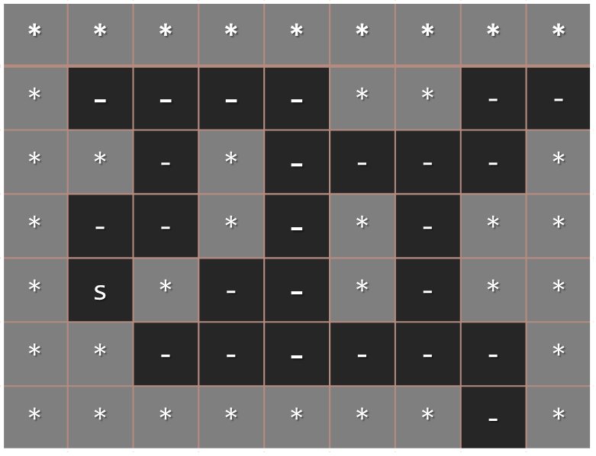
Lab Exercise
Find the Nearest Exit from a Labyrinth with BFS

Slide 48
Iterative DFS and BFS
What will happen if in the Breadth-First Search (BFS) algorithm we change the queue with a stack?
An iterative stack-based Depth-First Search (DFS)
BFS (node)
{
queue ← node
while queue not empty
v ← queue
print v
for each child c of v
queue ← c
}
DFS (node)
{
stack ← node
while stack not empty
v ← stack
print v
for each child c of v
stack ← c
}

Slide 49

Summary
Tree / graph traversal algorithms:
Depth-First Search (DFS)
Breadth-First Search (BFS)
DFS algorithm
Use recursion: traverse a node and recursively its child nodes
BFS algorithm
Use a queue: while not empty dequeue a node and enqueue its descendent nodes

Slide 50









Tree and Graph Traversal Algorithms
https://softuni.bg/trainings/1147/Data-Structures-June-2015

Slide 51
License
This course (slides, examples, labs, videos, homework, etc.) is licensed under the "Creative Commons Attribution-NonCommercial-ShareAlike 4.0 International" license
Attribution: this work may contain portions from
"Fundamentals of Computer Programming with C#" book by Svetlin Nakov & Co. under CC-BY-SA license
"Data Structures and Algorithms" course by Telerik Academy under CC-BY-NC-SA license

Slide 52






Free Trainings @ Software University
Software University Foundation – softuni.org
Software University – High-Quality Education, Profession and Job for Software Developers
softuni.bg
Software University @ Facebook
facebook.com/SoftwareUniversity
Software University @ YouTube
youtube.com/SoftwareUniversity
Software University Forums – forum.softuni.bg

